Slide 1


Green Pace
Security Policy Presentation
Developer: Luis Garcia

Slide 2

OVERVIEW: DEFENSE IN DEPTH
Defense in Depth refers to a security tactic where different layer of strategically thought methods are implemented to protect a system.

Slide 3
THREATS MATRIX
All security risk are important to check for. Some of them may cause the lost of important data others may cause lower risk, like problems when running the program.
Likely Loss of important data | Priority High
Low priority Undefined behavior | Unlikely May cause abnormal execution

Slide 4
10 PRINCIPLES
Validate Input Data – all data should be validated.
Heed Compiler Warnings - Means compiling and testing the code as much as possible.
Architect and Design for Security Policies – design and build that enforce the security policies.
Keep It Simple - Code design shall be kept as small and simple as possible.
Default Deny – access should be based in permission.
Adhere to the Principle of Least Privilege - This will allow users to only access the level of authorization they can access.
Sanitize Data Sent to Other Systems - Make sure that the data that is been sent to other systems is clean from vulnerabilities.
Practice Defense in Depth - Most system need more than one layer of protection, ensuring what layers are needed for each system is essential to protect the system.
Use Effective Quality Assurance - QA techniques are an important part of the process.
Adopt a Secure Coding Standard - Is important to have a secure coding standard. It goes with the others 9 principles.

Slide 5
CODING STANDARDS
Data Type – using the wrong variadic function can result in abnormal program termination.
Data Value – having unspecified values can cause a buffer Overload.
String Correctness – Dereferencing a null pointer is an undefined behavior, typically abnormal program termination.
SQL Injection – syntax that is ambiguous when declaring it can lead to unexpected program execution.
Memory Protection – writing memory that has been deallocated can lead to the execution of arbitrary code.
Assertions – assertion are important to test the code. Is a condition that is true and when it is not true mean the assertion failed.
Exceptions - Code that is not exception safe typically leads to resource leaks.
Input / output – input and output are performed in the form of a sequence of bytes or more commonly known as streams.
Declaration and Initialization – is important to obey the declaration rules or it can cause undefined behavior I the execution.
Containers – using an invalid iterator is similar to allowing a buffer overflow.

Slide 6
ENCRYPTION POLICIES
Rest – is a key protection against a data breach. It is importantly because it protects the sensitive company data. For example, if a hacker takes an encrypted hard drive without the key the hacker won't be able to access it.
Flight – is mean that the data is being encrypted while is being transmitted. This help protect the data while is being moved from place to the other. example is secure communication such as SSL and TLS.
In Use – is when the data is stored in no state and is always active. Data is never left insecure and is the newest approach to help protect data. The data is encrypted throughout the entire data life cycle.

Slide 7
TRIPLE-A POLICIES
Authentication – Allows verifying user identity based on a unique set of criteria. Example are username and passwords.
Authorization – defines whether a user has a permission to view certain information and to perform certain task. Example is the difference between a system administrator and the user.
Accounting – allows tracking and measuring user activity. An Example are the logs the interaction produces. Logs contain information about what was done in the system.

Slide 8
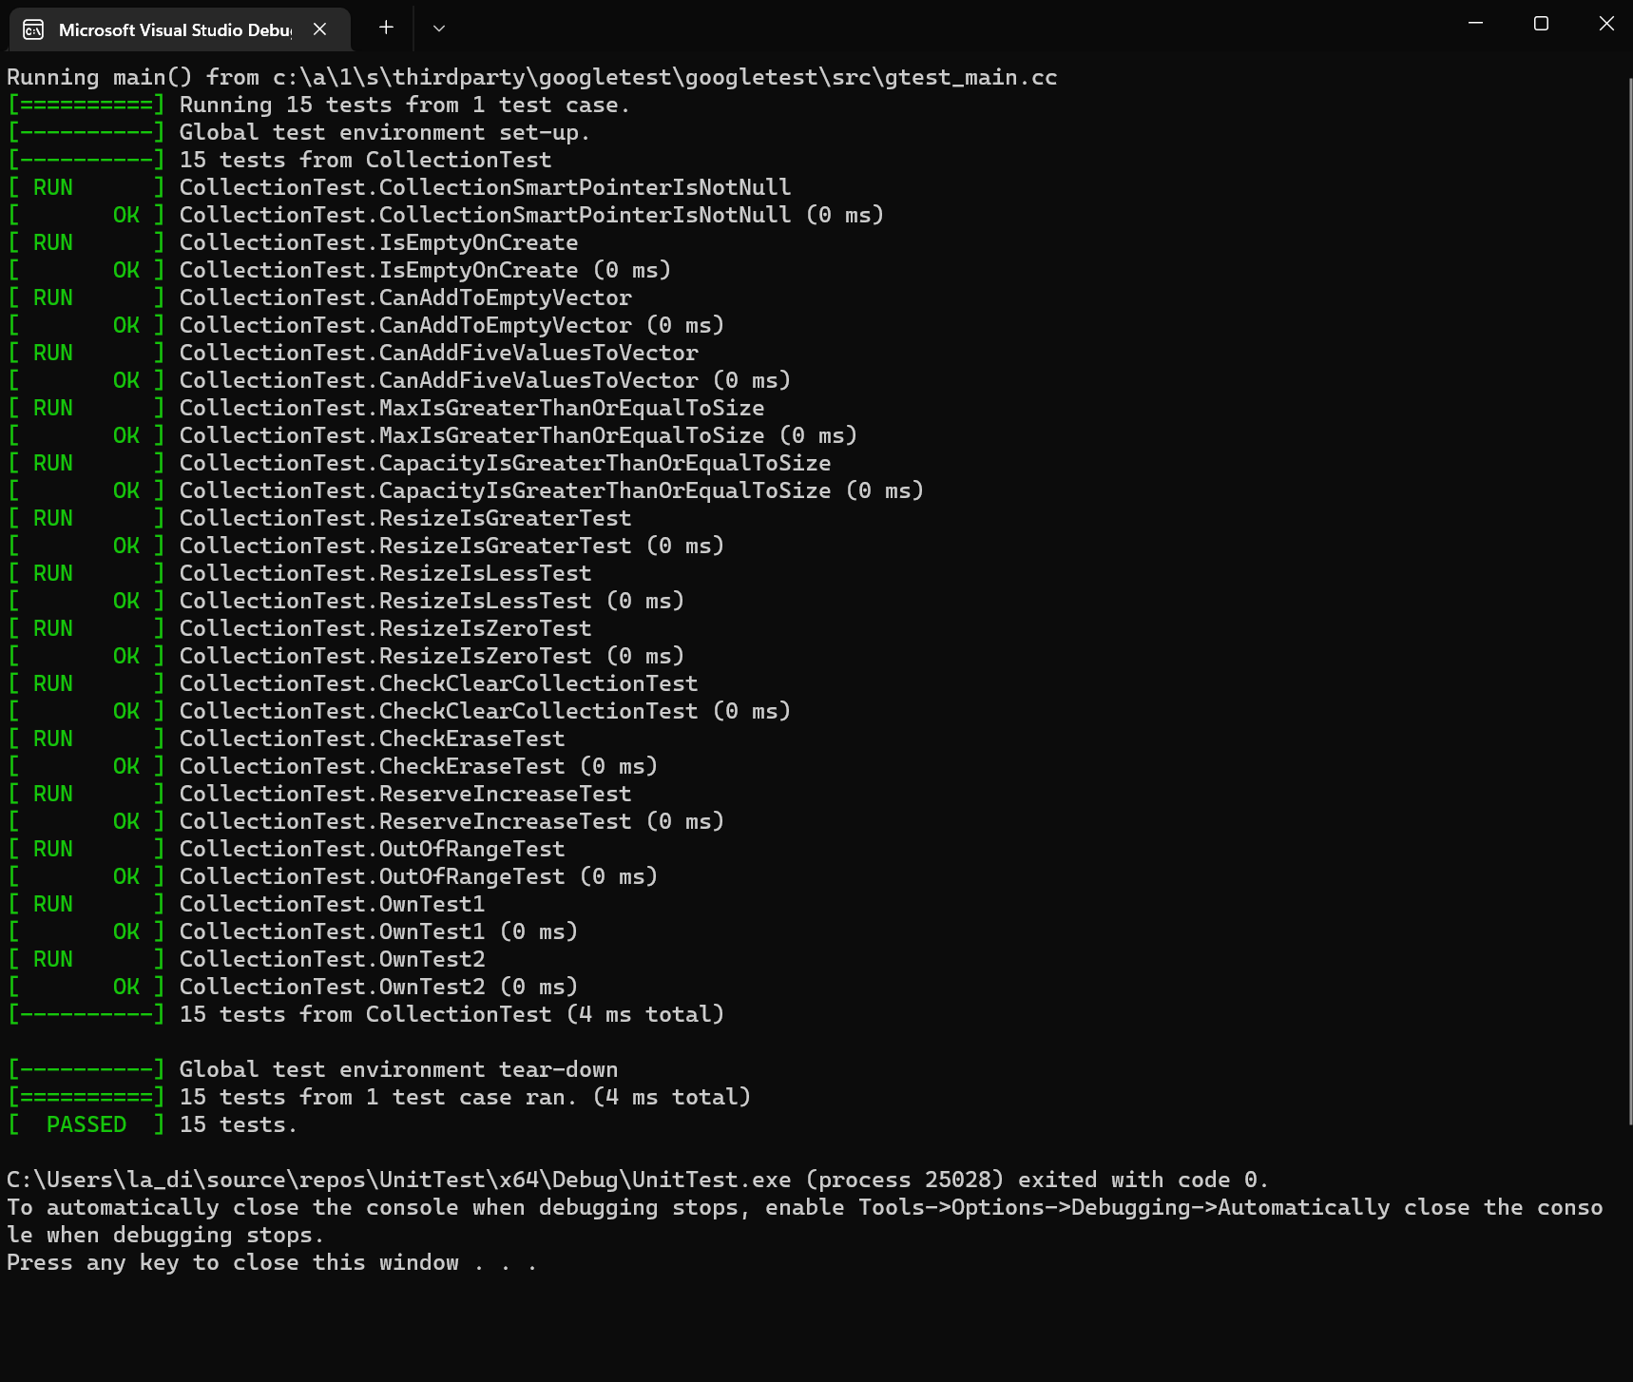
Unit Testing
In here we tested different unit using Assert and Expect functionalities.
There were 15 units tests.
2 of the tests where negative tests.

Slide 9
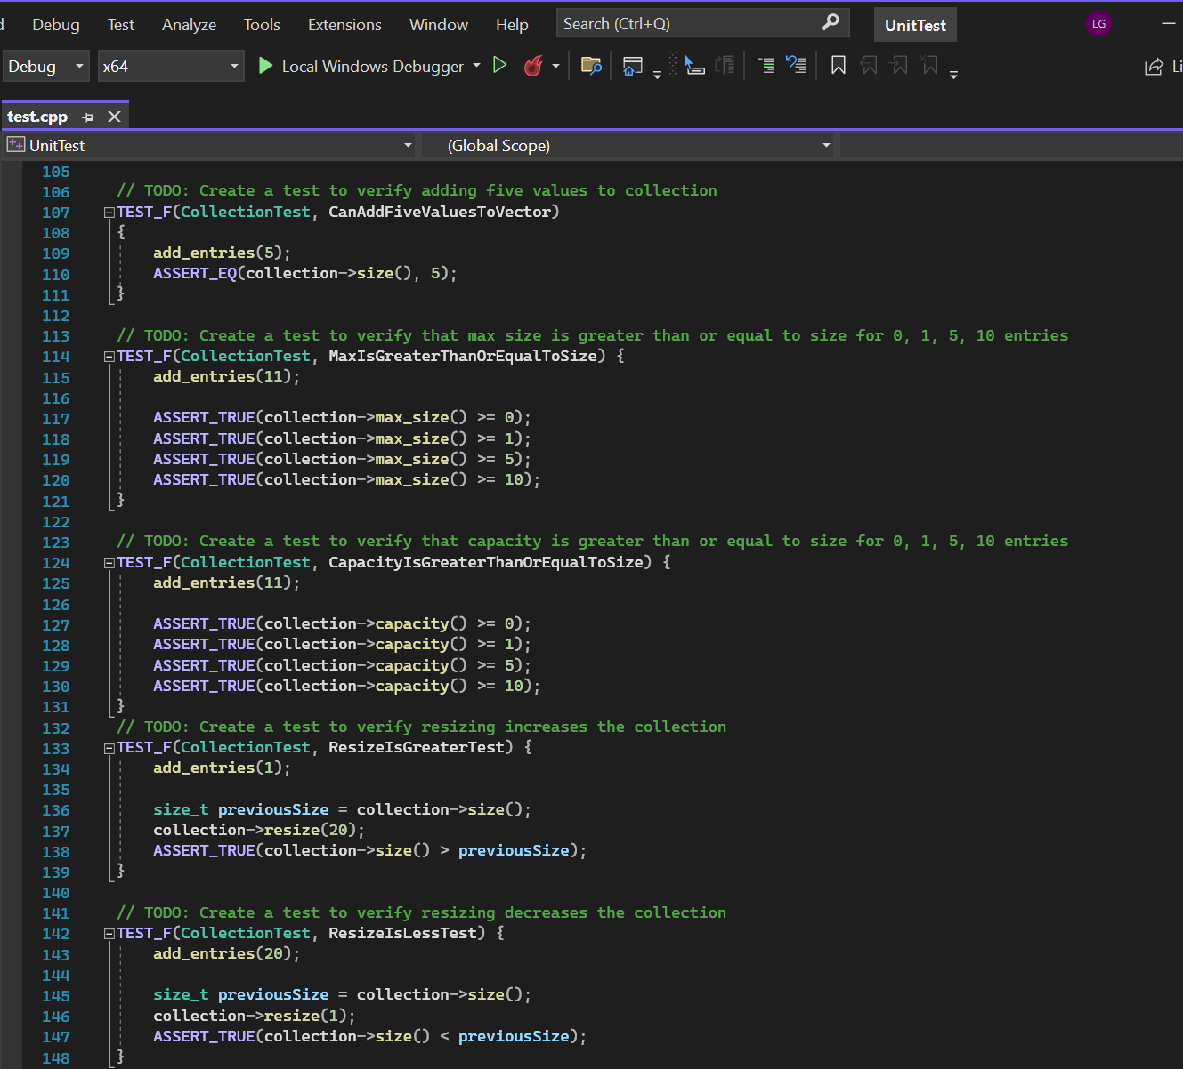
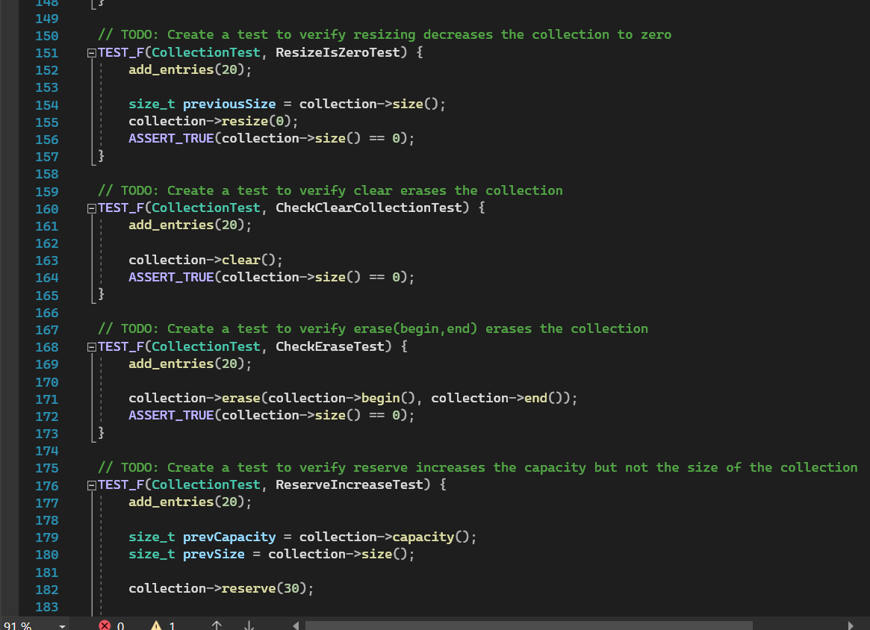
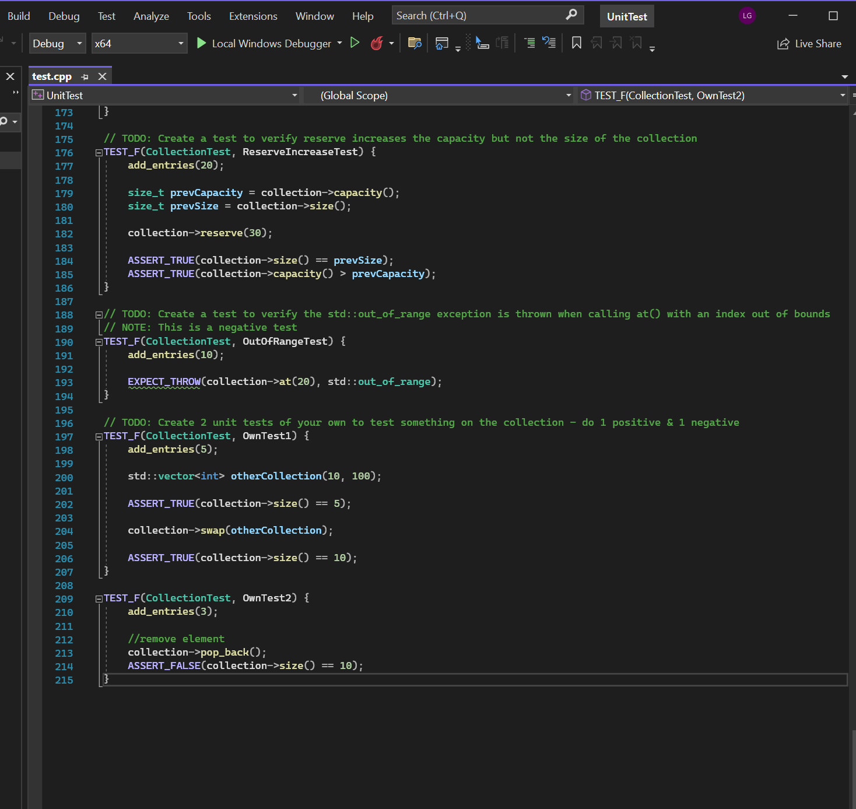
Unit Test in Code(comments to explain)

Slide 10

AUTOMATION SUMMARY

Slide 11
TOOLS
The DevSecOps pipeline is a secure method for coding that goes through different phases of the development lifecycle. The process enables the development of a more secure projects adding the speed of agile and devOps.
Automation is part of the process meaning the use of external tools are important to help our job to be more secure. Tools like CppCheck helps find vulnerabilities that developers won’t see on plain sights. Another tool that can be use is the IDE tools in our case we used Visual Studio tools help us with checking for vulnarabilities.

Slide 12
RISKS AND BENEFITS
There is no perfect coding. It doesn’t matter who we are we will always find something we can do better. Risk are always there and is our job to know them, understanding them and use the tools we have at hand to produce the most secure project we can.
Maintenance is an important part because there will always be someone trying to break in and there will always be new ways to patch does vulnerabilities.
The benefit of keep learning will help us be more secure and more productive. Always use the tools and always use a QA to test your code.

Slide 13
RECOMMENDATIONS
The most important recommendation is to keep up to date with the new vulnerabilities, threats and new solutions.
Therefore, Maintaining the code is important.
If we test our code piece by piece with unit testing for example, we will have a better result for when we need to maintain our code.
The use of Triple A in system to have our users checked and our system overall will be protected.
Use the tools in hand to be more effective and more secure.

Slide 14
CONCLUSIONS
In conclusion taking the necessary steps to be a more secure company is a must. Testing regularly, implementing DiD, and adopting all the rules and standards will transform us from a DevOps to a DevSecOps place. Adopting the more secure way will save us time and money, and it will make us more productive.

Slide 15
REFERENCES
GeeksforGeeks | A computer science portal for geeks
SEI CERT C++ Coding Standard - SEI CERT C++ Coding Standard - Confluence (cmu.edu)

